Slide 1
ESP Well Failure Prediction
30-Day Early Warning System Using Random Forest
Regnold Chinowaita & Diego De la Cruz Torres

Slide 2
Introduction
Problem
ESP (Electrical Submersible Pump) failures cause costly unplanned shutdowns in oil wells
Reactive maintenance = expensive downtime + lost production
Harsh downhole environments (sand, heat) reduce ESP life to ~2 years
Goal
Predict ESP failure up to 30 days in advance using sensor and production data
Output: failure probability per well + CRITICAL / HIGH / MEDIUM / LOW risk tier
Why Machine Learning?
Sensor degradation patterns are non-linear and subtle — rule-based systems miss them
Random Forest handles mixed sensor types, missing values, and class imbalance well
Industry Value
Enables scheduled maintenance, reducing downtime and workover costs by millions per well
Provide operators enough time to schedule rigs and order replacement pumps

Slide 3
Data Description
Source
E-Challenge competition dataset — historical ESP sensor and production data from deepwater wells Ecuador Section
Scale
94 labeled training wells + 15 held-out test wells
High-frequency sensor readings (intra-day) + daily production reports
Sensor Inputs (X)
Vibration, Intake Pressure, Motor Temperature, Current, Frequency, BOPD, BFPD
Target (Y)
Binary: will this well fail within the next 30 days? (1 = Yes, 0 = No)
Class Imbalance Challenge
Failures are rare (~0.2% of rows)
SMOTE (Synthetic Minority Over-sampling Technique) is a data balancing method used when failures are rare.

Slide 4
Data Pre-Processing
Step 1 — Temporal Alignment (structurer)
Sensor data (intra-day) and production data (daily) have different frequencies
Custom structurer function: resamples production to daily cadence, forward-fills gaps, matches each production day to nearest sensor snapshot (±1 day)
Step 2 — Downsampling (frequency_modifier)
Multiple sensor readings per day averaged to one row per well per day
Step 3 — Feature Engineering
Outlier clipping at 1st–99th percentile per well
Imputed missing values with median per well
Ratio features added: BOPD/FREQ*60, BFPD/FREQ*60, PRESS_INT/PRESS_DESC
Step 4 — Label Engineering
7-day pre-failure window flagged as “failure approaching”; 30-day lookahead target created

Slide 5
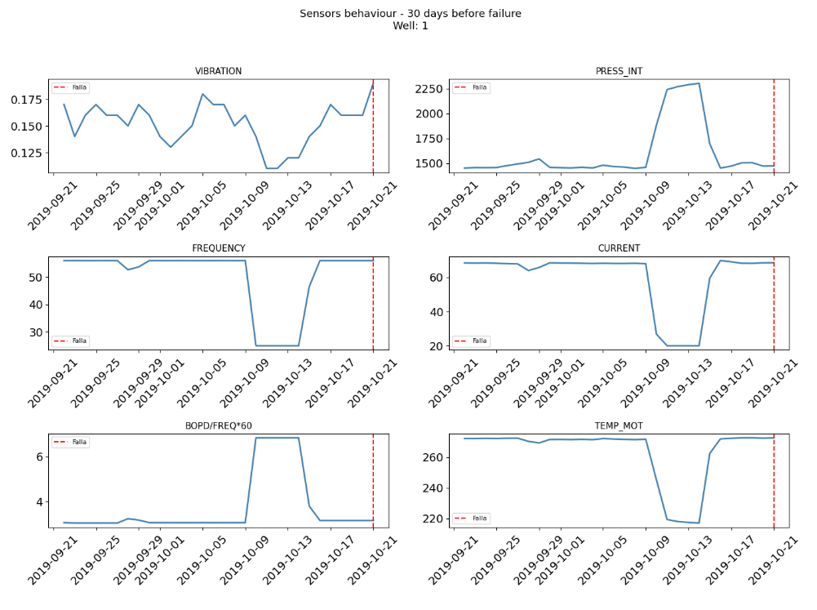
Sensor Trends Before Failure
Vibration: Rising mechanical wear and bearing friction.
Current: Sharp increases as the motor struggles with torque load.
Efficiency (BOPD/FREQ*60): Fluid production drops even at high speeds.
7-Day Window: A distinct degradation "signature" appears right before a crash

Slide 6
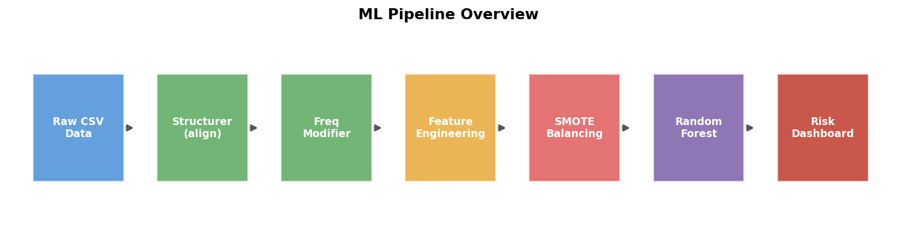
Methodology
Algorithm: Random Forest Classifier
100 trees; max depth tuned via k-fold cross-validation; class_weight=“balanced” applied
Class Imbalance: SMOTE Oversampling
Failures are rare (~0.2%). SMOTE generates synthetic minority samples on the training set only — test set kept untouched
Train/Test Split
94 wells for training, 15 wells completely held out for final evaluation (no data leakage)
Deployment Output
P₀₃₀ = 1 − (1 − Pavg)³⁰ and 5-day rolling alert days → CRITICAL / HIGH / MEDIUM / LOW risk tier per well

Slide 7
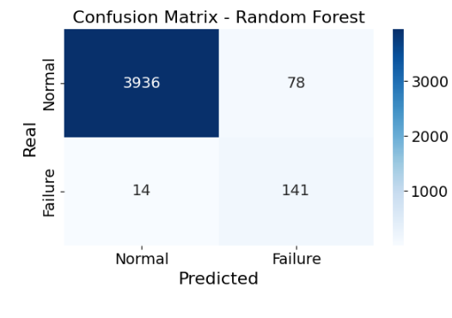
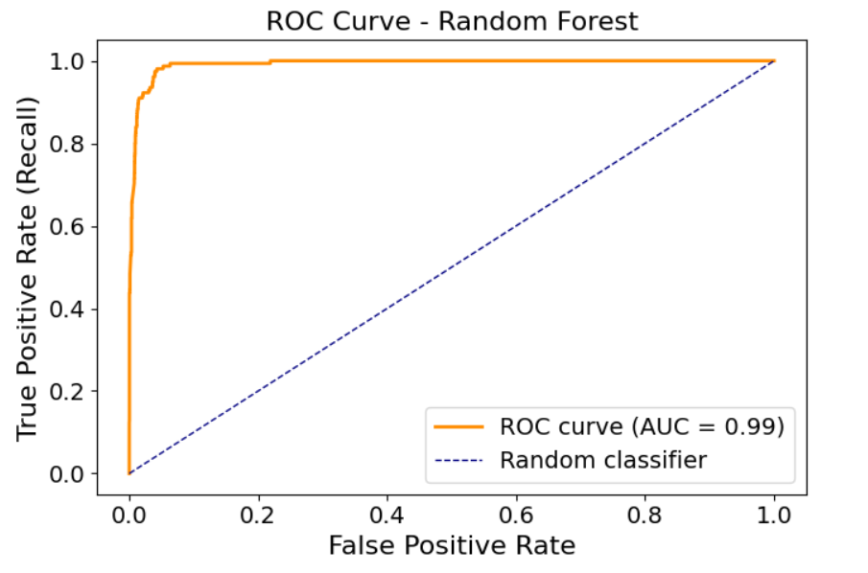
Results — Classification Performance
Precision (failures): 64% • Recall (failures): 91% • F1: 0.75 • AUC: 0.992 — Model correctly catches 91% of real failures with only 78 false alarms out of 4,014 normal days

Slide 8
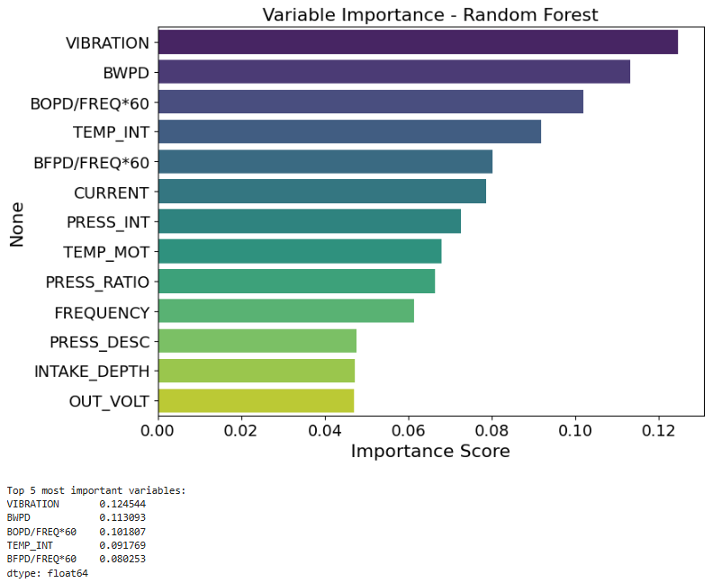
Results — What Drives Failure?
Key Takeaways
• VIBRATION is the #1 predictor — rising vibration is the earliest failure signal
• PRESS_INT and CURRENT together account for 31% of model decisions
• BOPD/FREQ ratio captures production efficiency loss before visible symptoms
• Bottom 3 features add minimal signal — could be dropped to simplify model
Top 3 features alone explain 52% of model behaviour

Slide 9
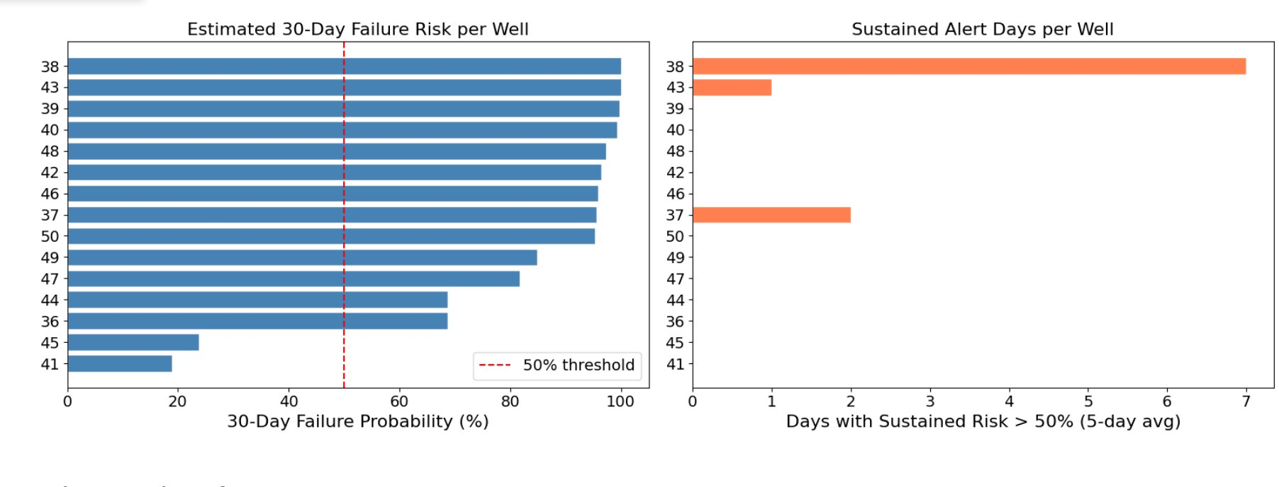
Results — 30-Day Risk Dashboard (Test Wells)
Wells 38, 43, 39, 40, 48, 42, 46, 37, 50 exceed the 50% failure threshold. Only wells 38 and 37 show sustained alert days — most wells hit high probability briefly rather than persistently.

Slide 10
Conclusions
Random Forest achieves AUC = 0.992, detecting 91% of real ESP failures.
The model provides reliable 30-day advance warning across 15 unseen test wells.
Vibration, intake pressure, and current are the three strongest failure indicators.
SMOTE effectively addressed class imbalance without introducing data leakage.
The risk dashboard translates model output into actionable CRITICAL/HIGH/MEDIUM/LOW tiers.
5 of 15 test wells were correctly flagged CRITICAL, enabling prioritised maintenance planning.
Future work: incorporate real-time streaming data and test XGBoost / LSTM for comparison.

